Slide 1
Innovation Geeks
IIM Calcutta
Girish Dev Kumar Chaurasiya
Sugandha Ranjan
Suman Pal
Ola money

Slide 2
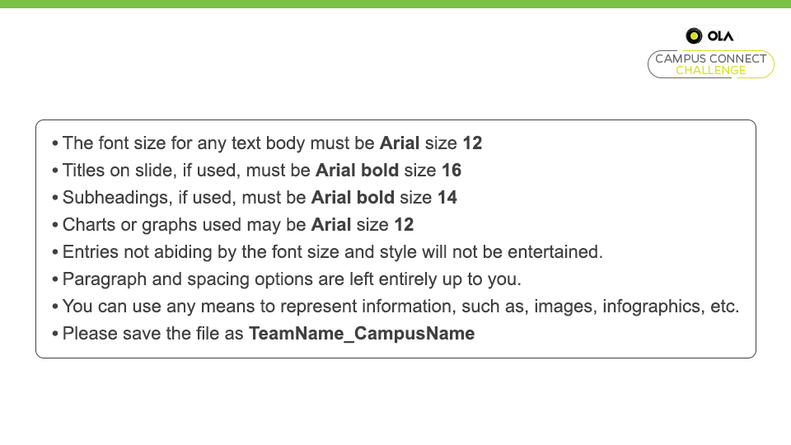

Slide 3
Demand
Culture: Credit (udhaar) is looked down upon which makes consumers reluctant from purchasing credit cards
Lack of awareness: Credit cards and their benefits are not widely publicized
High penal interest: penal interests are as high as 49% which instill apprehensions over the huge penalty that might be charged
Increased expenditure: The thought that credit cards might affect the lifestyle, making people spend more than their income levels, stops them from keeping one.
Fraud apprehension: non- existence of laws that holds all companies and institutions liable for security breaches
Credit card issuers not providing lucrative offers: Lack of targeted offerings and incentives
Adversities Faced By Credit Card Market And Proposed Solutions In Indian Context
Supply
CIBIL score : only 10% of the total population is eligible for the credit cards as per the CIBIL score
Lack of proper consumer segmentation: Unlike US and China, Indian market lacks in terms of proper segments such as students, elderly, low income groups.
Lack of supply channels in Rural areas: Rural areas in India lack in basic amenities such as banking facilities, Internet facilities.
Government policies: India has stringent policies that restrict entry of new players in the banking sector.
Fierce Competition: Banking sector in India is congested and is highly competitive which poses immense challenges in sustainability of new entrants
Problems
Positioning
Rural: collaborate with government in providing incentives, resolving internet issues, helping rural business to start accepting credit cards, providing more banking locations in rural areas.
Housewives: special offers on grocery shopping and gender specific offers such as parlour, apparel shopping.
Financial education: In conjunction with Indian government, Ola credit card may come up with campaigns in order to instill confidence in people
Low income groups: lower income groups can be provided with credit cards with lesser limits and suitable offerings based on their spending trends.
Older age: chatbot assistance; can have a dedicated card for this segment with rebate on penal interest rate.
Students: UG/PG students shall be offered cards with limits as per their family income
Solutions
Segmentation
RURAL VS URBAN
GENDER
AGE GROUPS
INCOME GROUPS
GROUPS BASED ON FINANCIAL EDUCATION LEVEL
Targeting
Rural : There is an inherent barrier in reaching out to rural population due to lack of proper distribution channel and facilities.
Housewives : They tend to depend on their family income in order to carry out any financial activities which keeps them from obtaining a card.
Limited financial education : Low financial education tends to make people apprehensive about credit card usage and applications
Low income groups: At present, targeted offerings to low income groups are close to non-existent
Older age: At older Age, people tend to have savings and are generally settled
Students: a high potential untapped segment, that requires some easy payment options for daily expenditure and academic activities

